Slide 1

AHMEDABAD INSTITUTE OF TECHNOLOGY
Department of Information Technology
Project:- Ola Data Analysis
Guide Name: Dr. Harsha Padheriya
Student Name: Kapadiya Jenish VIshnubhai
Enrollment No: 210020116063

Slide 2
Outline
Abstract
Introduction
Module’s Details
Technology Used
Offer Letter

Slide 3
Abstract
This study focuses on analyzing Ola's operational and customer data to gain insights into ride patterns, pricing dynamics, demand forecasting, and customer satisfaction. The key objectives include understanding factors influencing ride demand, identifying peak hours and high-demand zones. The experimental setup involves data collection from publicly available sources, preprocessing for handling missing values and outliers, and exploratory data analysis (EDA) using visualization techniques such as heatmaps, boxplots, and time-series graphs. Analysis suggests that dynamic pricing adjustments, optimized driver allocation, and customer loyalty programs can enhance operational efficiency and improve user satisfaction.

Slide 4
Introduction
The OLA Data Analysis project focuses on examining ride-sharing data to uncover meaningful insights into customer behavior, ride patterns, peak usage times, and operational efficiency. By analyzing datasets related to trips, users, drivers, and payments, this project aims to support data-driven decision-making for enhancing service quality and user experience. Tools such as Google Colab (for data processing), MySQL (for data storage and querying), and Power BI (for interactive dashboards) are used to perform comprehensive data analysis and visualization.

Slide 5
Module Details
1. Data cleaning Process In Goggle Colab
2. Performing Query in MySQL
3. Power BI Transformations
4. Visualization & Enhancing Visuals

Slide 6
Data Cleaning Process
Data cleaning was performed using Python in Google Colab to ensure accuracy and consistency in the dataset. This included handling missing values, removing duplicates, correcting data types, and filtering out invalid or irrelevant entries. Pandas libraries were used for efficient data manipulation, ensuring the dataset was ready for accurate analysis and visualization.

Slide 7
2. Performing Queries in MySQL
Loaded cleaned OLA dataset into MySQL for analysis.
Performed SQL queries to answer key business questions:
Retrieved successful bookings and UPI payments
Calculated average ride distance by vehicle type
Analyzed ride cancellations and their reasons
Identified top customers by ride count
Measured driver ratings and booking values

Slide 8
3. Power BI Transformations
Imported cleaned and structured data into Power BI
Transformed columns for proper data types and formatting Create
Built interactive visuals and dashboards to answer key questions:
Ride trends and distance distribution over time
Booking status and cancellation reason breakdowns
Revenue analysis by payment methods
Customer vs. driver rating comparisons
Top vehicles and high-value customers identified visually

Slide 9
4. Visualization & Enhancing Visuals
Overall Page
Vehicle Type Page
Revenue Page
Cancellation Page
Rating Page

Slide 10
Technology Used
Frontend: Power BI
Backend: Data sources (CSV, Excel, SQL Database)
Additional Tools: Python (for preprocessing), SQL

Slide 11
Project Scheduling
Week 1: Project Planning
Defined scope, selected tools (Python, MySQL, Power BI), created roadmap.
Week 2: Requirement Analysis
Identified insights needed, finalized KPIs based on stakeholder needs.
Week 3: Data Collection
Collected datasets from CSV files or simulated OLA ride data.
Week 4: Data Preprocessing – Part 1
Cleaned data by handling missing values and removing duplicates.
Week 5: Data Preprocessing – Part 2
Structured data formatting (dates, locations) for analysis readiness.

Slide 12
Week 6: Exploratory Data Analysis (EDA)
Used Python to visualize trends, peak hours, and ride behavior.
Week 7: Database Design and Setup
Created MySQL database with tables, relationships, and queries.
Week 8: Advanced Data Analysis
Analyzed driver ratings, customer satisfaction, and pricing trends.
Week 9: Visualization and Dashboarding Built interactive dashboards in Power BI with charts and maps.
Week 10: Testing and Review Validated data, queries, and dashboards; fixed inconsistencies.
Week 11-12: Documentation and Final Report Compiled full report and prepared presentation for project demo.

Slide 13
System Analysis
Study of Current System
Ola uses historical data for ride demand, pricing, and sentiment, but lacks real-time insights.
Problems Identified
Unclean and inconsistent data
Absence of interactive dashboards
Requirement of New System
Real-time, interactive, and structured data visualization using Power BI, MySQL, and Python.
Feasibility Study
Technically and economically feasible with tools like Power BI (for dashboards) and Python (for ETL and analytics).
Functional & Non-Functional Requirements
Data cleaning, visualization, pricing strategy, user behavior tracking
High performance, accuracy, usability, and extensibility

Slide 14
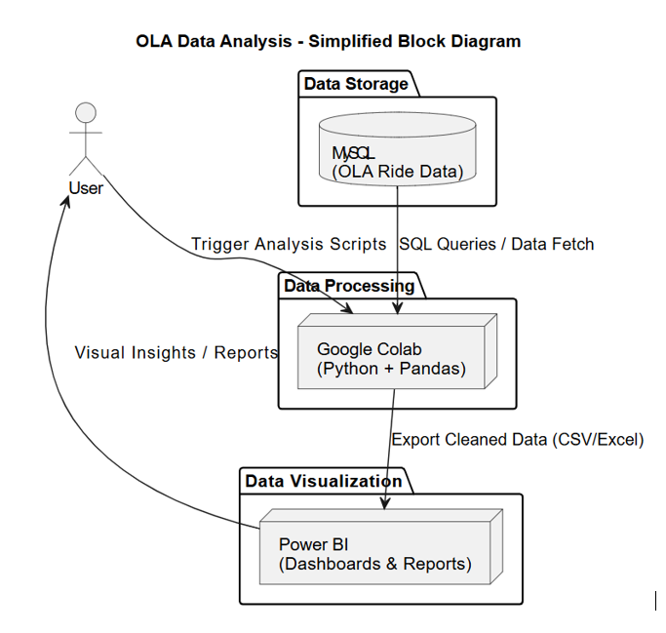
Block Diagram

Slide 15
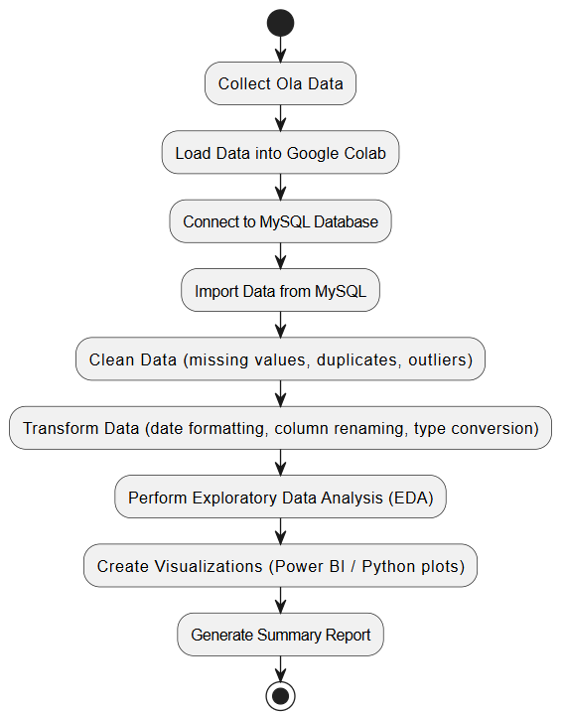
Flow Chart

Slide 16
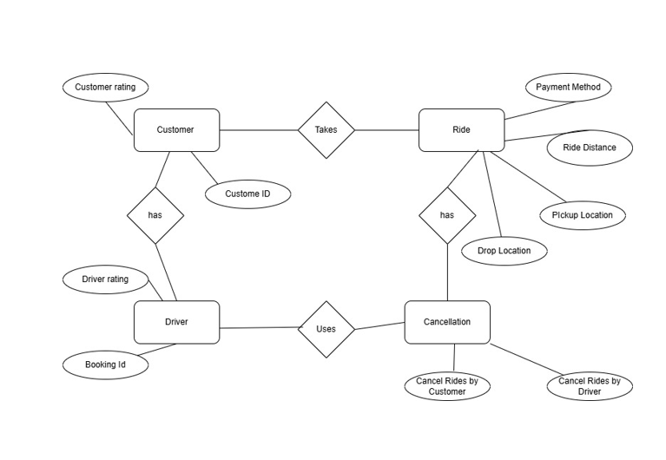
ER Diagram

Slide 17
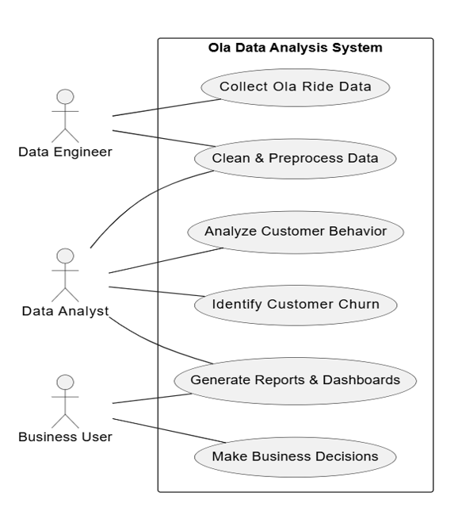
Use Case Diagram

Slide 18
Use Case Diagram

Slide 19
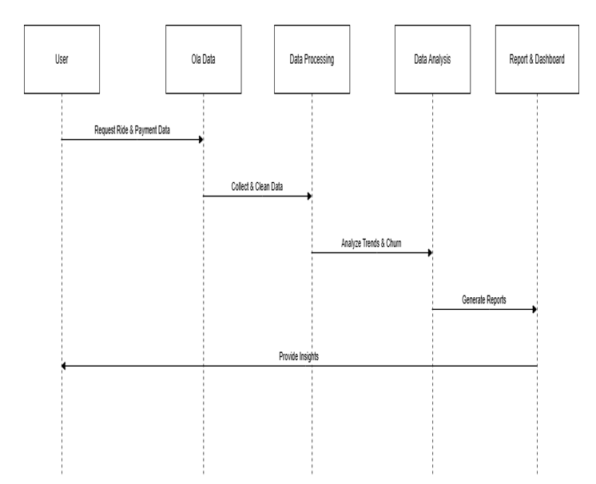
Sequential Diagram

Slide 20
Implementation
Technology Stack
Tools Used
Google Colab (Data Cleaning), MySQL (Data Storage), Power BI (Visualization).
Data Preprocessing
Google Colab Process
Handling missing values, removing duplicates, and formatting data.
Data Storage & Querying
MySQL Setup
Schema design and data storage strategies for ride data
Dashboard Creation
Power BI Dashboards
Creating interactive visual reports for performance monitoring.

Slide 21
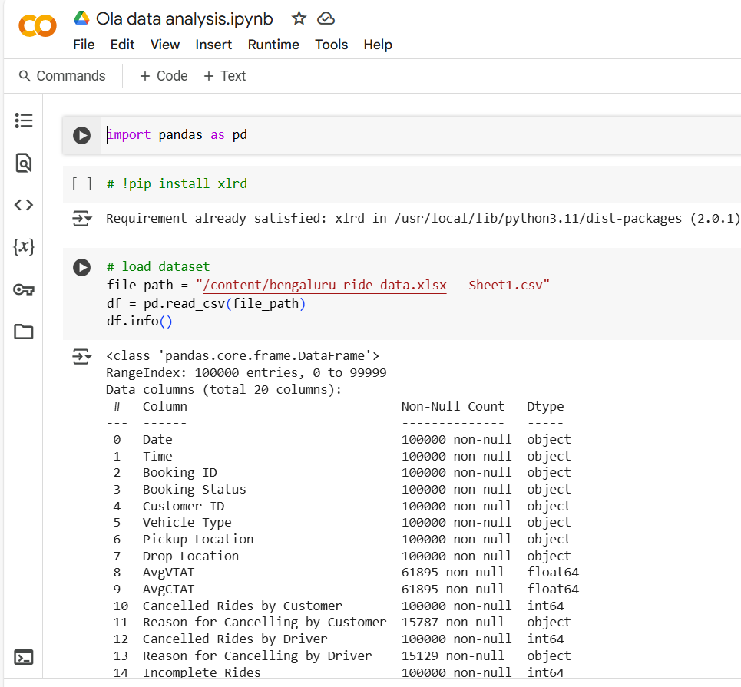
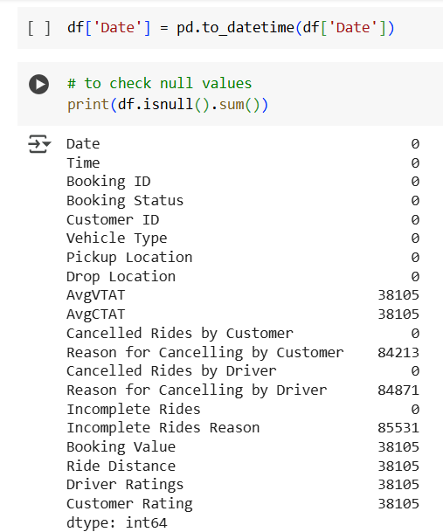
Cleaning Process

Slide 22
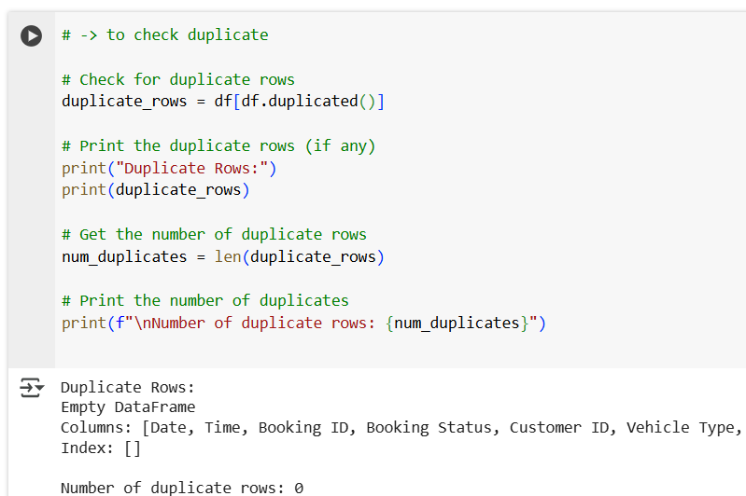
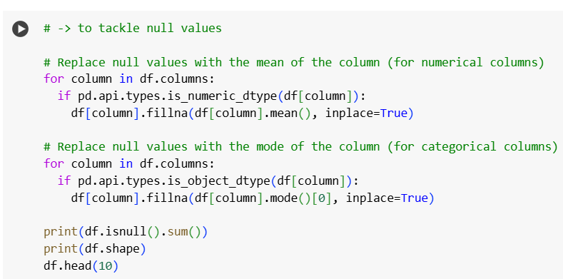
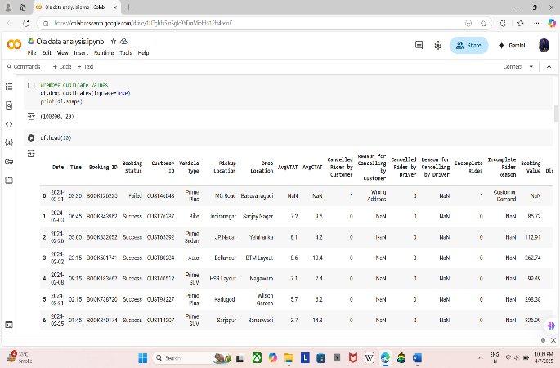
Cleaning Process

Slide 23
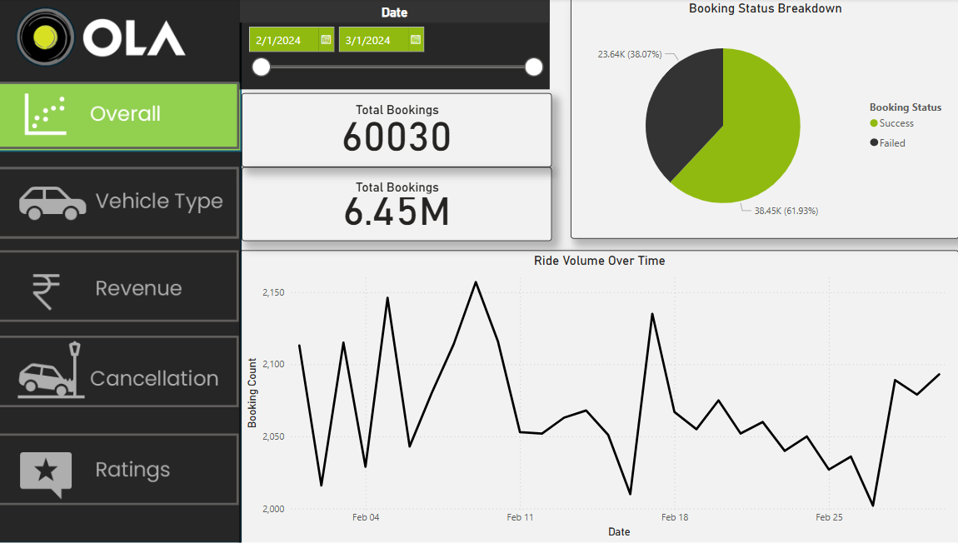
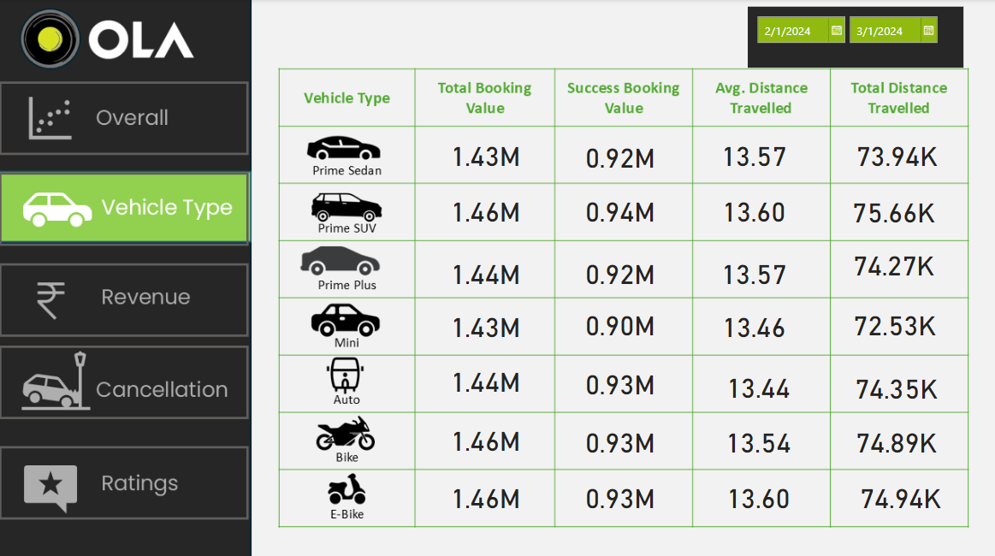
Power BI Dashboard

Slide 24
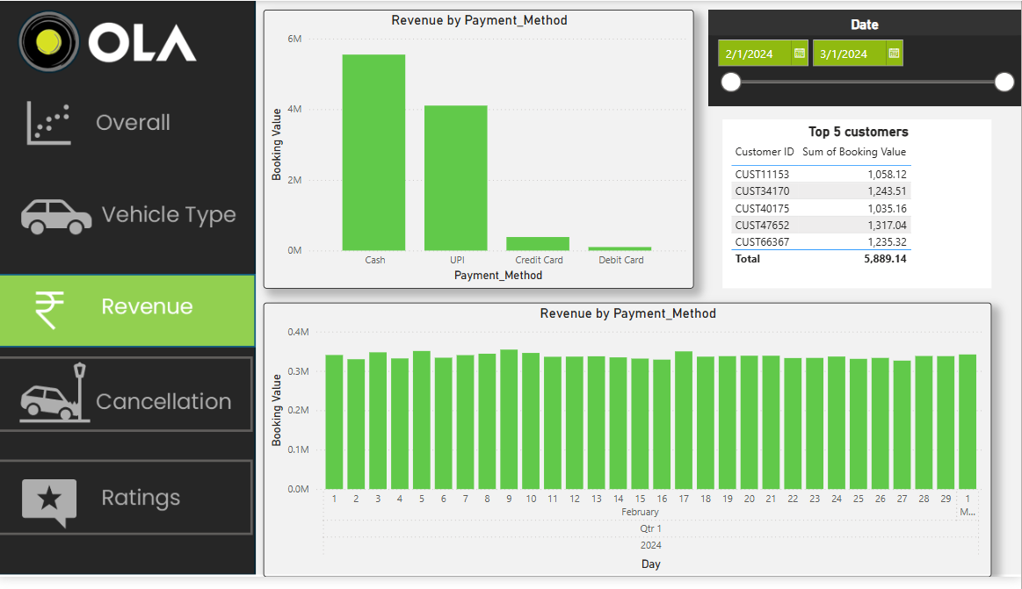
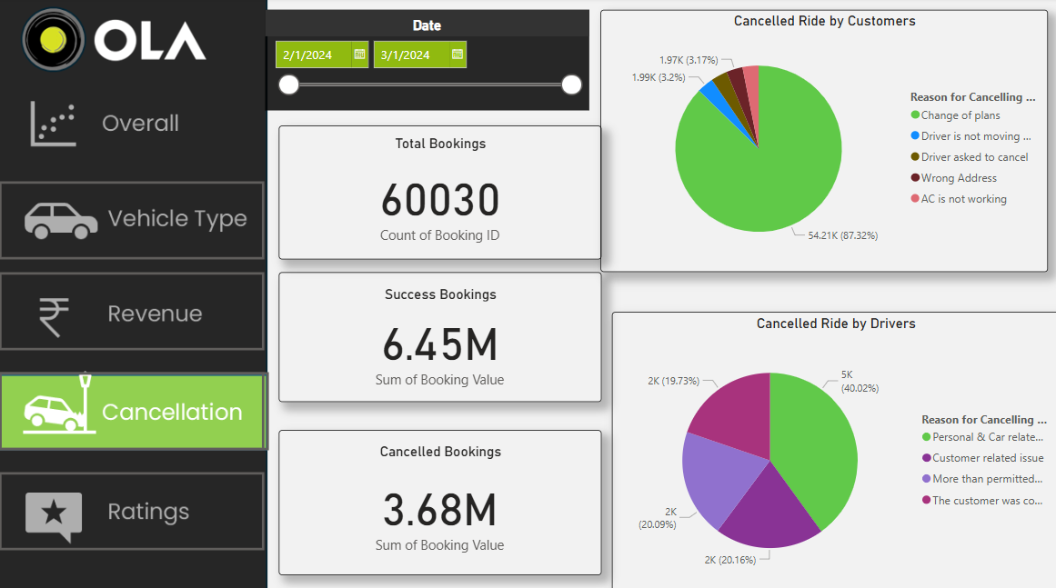
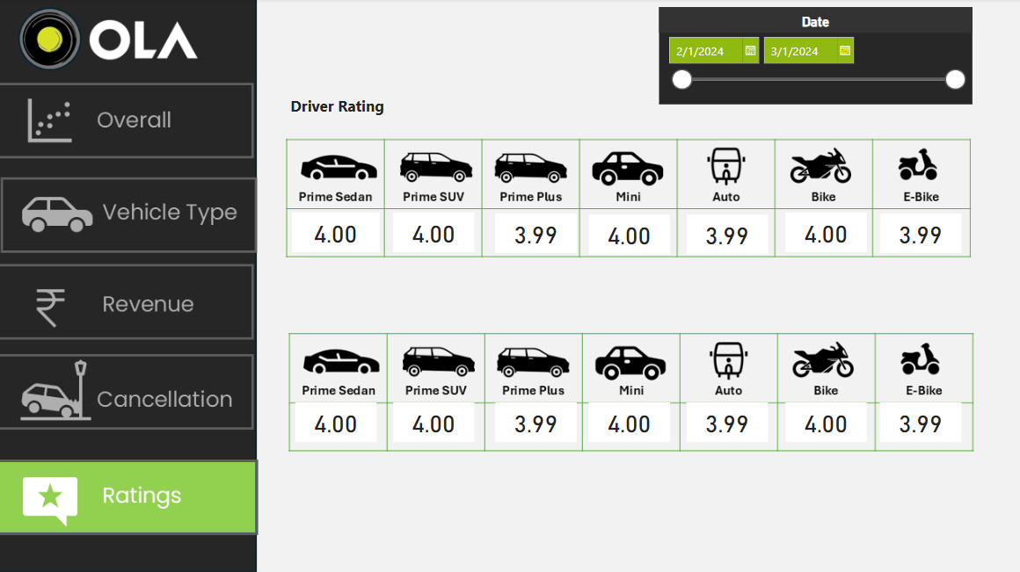

Slide 25
Conclusion
Overall Insights:
Identified key trends: peak hours, ride types, high-demand zones
Tools used: Python for analysis, MySQL for storage, Power BI for dashboards
Challenges Faced:
Data cleaning & volume handling
Integration issues between tools
Future Enhancements:
Real-time analytics using APIs
Predictive modeling for cancellations & demand
Improved data security
Advanced drill-down dashboards

Slide 26
Thank You

Slide 27
